Slide 1

MTA data utilization
NOUF ALSAEED

Slide 2




Overview
MTA DATA
EDA
Stations
Mall

Slide 3
Data description
Column name | Description
STATION | Stations names
WEEK_DAY | Week day names
TOTAL_ENTRIES | Total entries per date and time
TOTAL_EXITS | Total exits per date and time
TOTAL_TRAFFIC | Total traffic

Slide 4
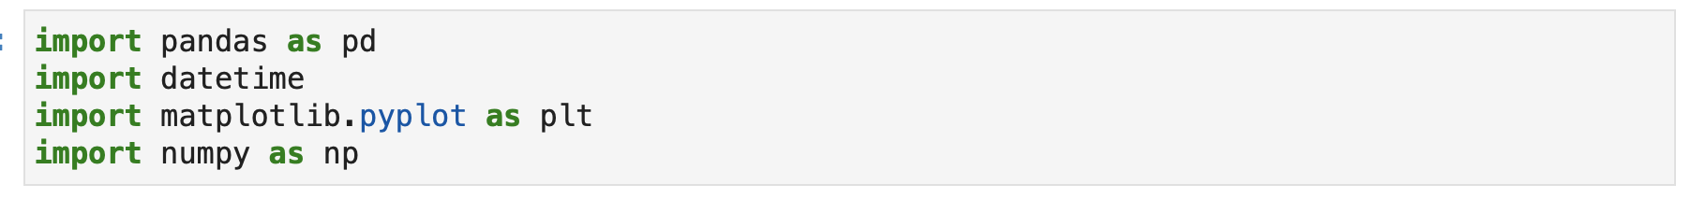
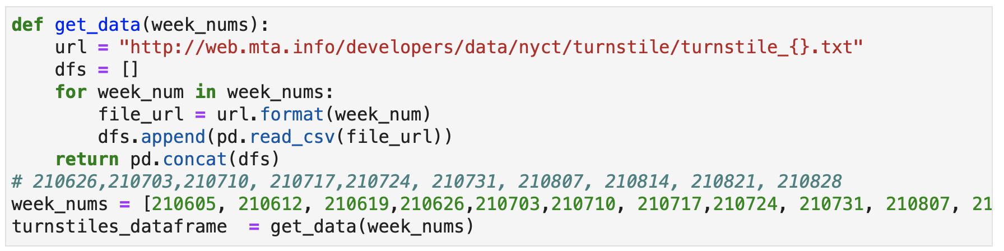
Code description
Importing libraries and uploading data

Slide 5
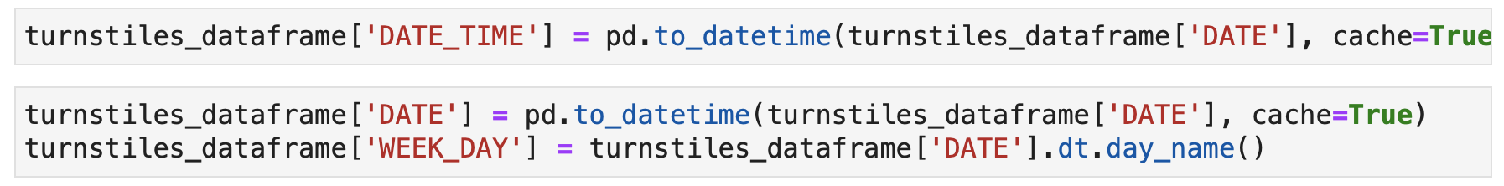
Code description
Preprocess data

Slide 6
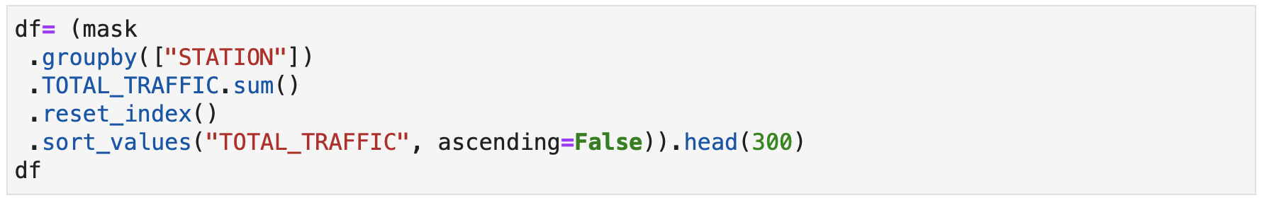
Code description
Preprocess data

Slide 7
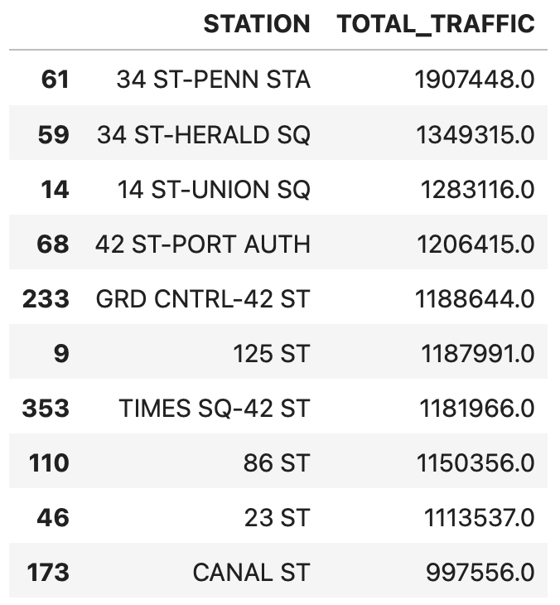
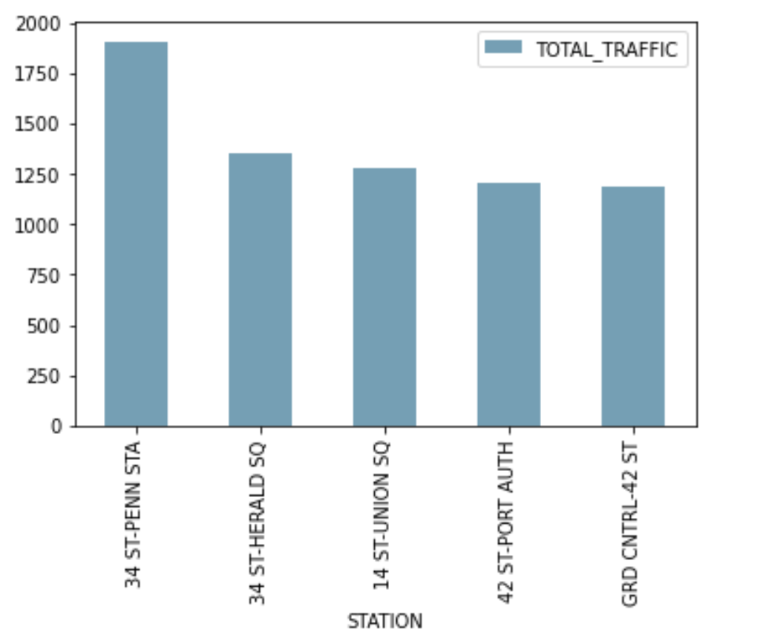
Results

Slide 8
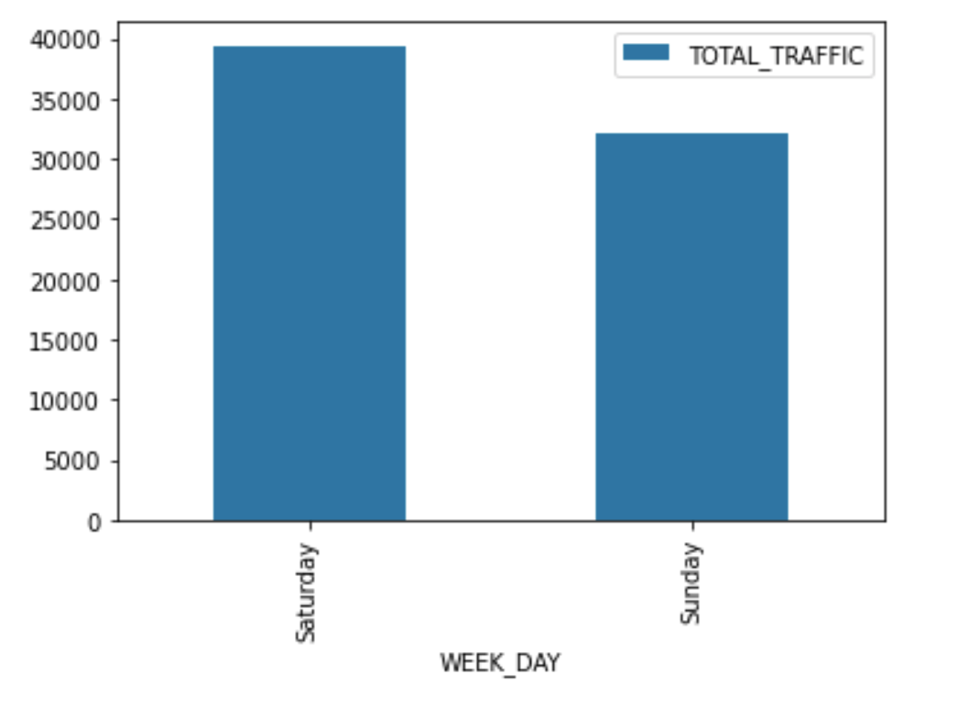
Results

Slide 9
Thank you

Slide 10
Reference
1. MTA. 2021. About Us. [online] Available at: <https://new.mta.info/about-us> [Accessed 30 August 2021].

